Slide 1


BUSINESS & HUMAN RIGHTS 101 – LEARNING RESOURCE
CEE&CA Summer Academy on Business and Human Rights 2024
The Global Business Initiative on Human Rights

Slide 2


Module 2.1
SOME FIRST STEPS:
Directions and roadmaps and making a policy commitment

Slide 3

Direction and roadmaps
The task of embedding respect for human rights across a company can seem overwhelming. But it needn’t be so. It’s a matter of identifying where to start – and what to do next, and then again after that. By breaking the work into manageable stages, and prioritising these, you can set a roadmap for this work.
A roadmap can also be a helpful tool for communicating the company's approach and priorities to stakeholders. Your plan doesn’t need to be final – it may make sense to course-correct over time, revisiting your priorities, goals and strategies.
Play this video direct on Vimeo here

Slide 4
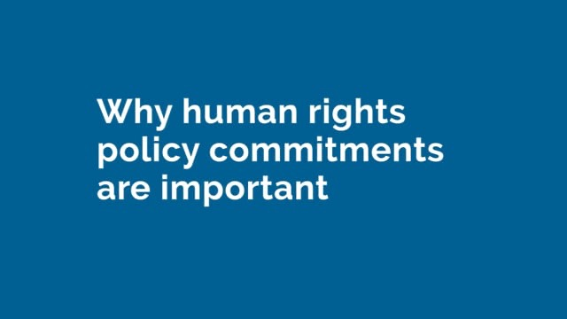

Making a policy commitment
COMMUNICATING A COMPANY COMMITMENT TO RESPECT HUMAN RIGHTS
All companies can be involved in human rights impacts – and all companies have a responsibility to respect human rights.
Making a policy commitment to respect human rights is an important step in a company’s journey to meet its human rights responsibilities. It signals – internally and externally – that the company understands what is expected and takes its responsibilities seriously. Processes to develop a policy commitment can also be a great way to raise awareness internally and strengthen relationships with stakeholders. And they can play an important role in establishing a rights-respecting culture.
It’s not always necessary to develop a standalone human rights policy. A human rights statement may be enough. What's important is that it clearly communicates the company's commitment to meet its responsibility to respect human rights.
Play this video direct on Vimeo here

Slide 5
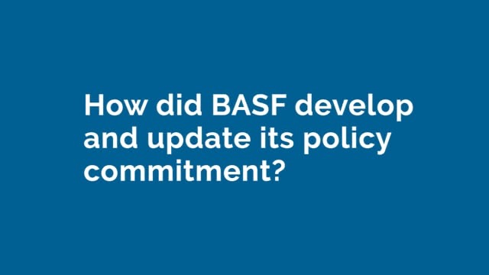
What does making a policy commitment look like in practice?
WAYS TO DEVELOP A POLICY COMMITMENT:
Launch a process to consult with leaders and key colleagues on the content of the policy commitment.
Engage with external stakeholders to test the proposed policy or statement.
Seek formal approval of the policy commitment from the highest levels of the business.
WAYS TO FOLLOW THROUGH ON A POLICY COMMITMENT:
Proactively disseminate the policy commitment internally and externally – for example, as TotalEnergies does in its Human Rights Guide.
Clarify lines of responsibility and accountability for delivering on the policy commitment.
Put in place policies and processes to ensure that the company meets its policy commitment.
Play this video direct on Vimeo here

Slide 6

What do the UNGPs say about policy commitments?
The UN Guiding Principles on Business and Human Rights, or UNGPs, expect companies to express their commitment to meeting their responsibility to respect human rights through a statement of policy.
KEY GUIDANCE ON MAKING A STATEMENT OF POLICY INCLUDES:
Policy statements should be publicly available and actively communicated internally and externally to personnel, business partners and other relevant stakeholders.
Policy statements should articulate the company’s expectations of its personnel, business partners and other entities directly linked to its operations, products or services.
Companies should aim for coherence between their policy statement and policies and procedures that govern their wider business activities and relationships.
→ See Guiding Principle 16 for more.

Slide 7
Insights from business practice
GBI companies have been learning what works, and what doesn’t and sharing their insights to help improve business practice. Here is a summary of some of our findings on POLICY COMMItMENTs.
Policy commitments can help position a company on human rights.
Statements of a company’s policy commitment can take different forms.
Building support and confidence amongst leaders, lawyers and other colleagues is critical.
The process to develop a policy commitment can be as valuable as the end product.
It can be helpful to refresh a policy commitment periodically.
It’s important to proactively communicate and embed a policy commitment.

Slide 8

Policy commitments can help position a company on human rights
Policy commitments can position the company externally on human rights.
They communicate the company’s commitment, its awareness of key challenges and salient risks, and its ambition to embed respect for human rights in its business activities and business relationships. They can also elevate the human rights discussion internally and establish a mandate to move ahead.
A policy commitment can also be helpful when engaging with or responding to questions from customers, banks, governments and other stakeholders.
In addition to supporting consistent communications, the policy statement helps demonstrate the company’s commitment.
However, it’s important to ensure follow-through on a policy commitment. A strong commitment that is not supported by concrete actions to identify and manage human rights challenges is unlikely to build stakeholders’ trust and confidence.

Slide 9
Statements of a company’s policy commitment can take different forms
There’s no one right way to make a statement of policy commitment.
Some companies introduce a formal human rights policy. Some make a human rights statement that expresses the company’s commitment to meeting its responsibility to respect human rights. Others embed the company’s commitment in its code of conduct.
What matters is that the statement of commitment is effective in communicating the company’s seriousness about this work – and that it sets the company’s ambitions for this work. This can vary with a company’s culture and structure. In some companies, the code of conduct is the primary reference point for business conduct, and this may be the most powerful way to express and begin to embed respect for human rights. In other companies, formal policies may be more important. For some, a separate statement can help focus attention on human rights issues. In others, a consolidated responsible business policy may be more effective.
Pragmatism can also be a key consideration. It may be helpful to begin with a simple human rights statement, then ‘upgrade’ this to a more comprehensive or formal policy commitment over time.

Slide 10
Building buy-in and confidence, amongst leaders, lawyers and other colleagues is critical
Without strong support from leaders and key colleagues, efforts to develop a policy commitment are unlikely to succeed.
Practitioners observe that colleagues often ask why a separate statement or policy on human rights is necessary. Having a clear and compelling response can help build support for a human rights policy commitment. Internal education about how the company can impact human rights and what its stakeholders expect can lay a helpful foundation for these discussions.
Incorporating content on the company’s salient human rights issues can also help make the policy commitment feel relevant.

Slide 11
The process to develop a policy commitment can be as valuable as the end-product
The process to develop a policy commitment creates an opportunity to engage with senior leaders and colleagues across the business on the company’s human rights responsibilities. These discussions can help raise awareness and understanding and strengthen commitment.
The process to develop and finalise a policy commitment is often longer than expected. It will likely involve many drafts and discussions with key internal and external stakeholders.
Whilst it can be slow, this process of engagement can help strengthen the content of the policy and smooth the approval process. For many companies, this process will involve benchmarking against peers, internal discussions, workshops with internal and/or external stakeholders, the review of multiple drafts by managers, senior leaders and external stakeholders, and final approval or presentation to executive management or the Board.

Slide 12
It can be helpful to refresh a policy commitment periodically
Refreshing a policy commitment creates an opportunity to update the content. It can also be a great way to renew the company’s commitment to this work and re-energise colleagues and stakeholders.
Many companies make their first human rights policy commitment early on in their human rights journey. This can be helpful to set direction, communicate leadership commitment proactively and create an internal ‘mandate’ for this work. But after a few years, things can change. You may have a better understanding of the company’s key risks - and a stronger sense of what stakeholders expect to see in the company’s policy commitment. If the business has evolved, the company’s human rights risk landscape may have changed, and the policy commitment may need to be updated to keep it relevant.
However, it’s important to ensure a refresh is valid and well-timed. If not, you may risk diluting rather than strengthening the existing policy commitment.
Key elements of a human rights policy commitment can also be embedded in other policies, such as the company's Code of Conduct and Supplier Code of Conduct, and it is important that the wording between policies is consistent.

Slide 13
Its important to proactively communicate and embed a policy commitment
Efforts to follow-through on a policy commitment can (and should) take a number of forms.
It is important to ensure that employees, contractors and other business partners know about the company’s policy commitment and understand what it means for their role. To do this, some companies integrate basic mandatory training, as well as more specialised training for leaders and those in key functions, and also develop a human rights guide.
To ensure the policy will have impact, it is also critical to ensure lines of accountability are clear. Linking compliance with, or implementation of, a policy commitment to the responsibilities of a particular leader or team can be helpful. It will also be important to ensure lines of communication up to the most senior levels of the company.
Finally, efforts to embed the policy commitment will require the integration of the company’s human rights responsibilities and commitments into core operating policies and processes. This can take time and won’t happen overnight. But stakeholders will expect to see serious and sustained effort to progress this.

Slide 14
Strengthening commitment to respect human rights
The number of companies that have made human rights policy commitments has increased significantly in recent years. As efforts to advance and increase business respect for human rights progress in the coming years, we need to find ways to reduce barriers to taking this important step.
Raising awareness about human rights and business
A key challenge for business practitioners – particularly in companies newer to managing human rights challenges – is building colleagues’ familiarity with the company’s human rights risks and responsibilities. And their awareness that the company has human rights responsibilities that stakeholders expect it to meet. Individual practitioners can do a lot to raise awareness and build commitment internally. But if we can find ways to raise awareness of the link between business and human rights, more progress could be made, faster.

Slide 15
Strengthening commitment to respect human rights
Navigating expectations on follow-through
Making a policy commitment to meet the corporate responsibility to respect human rights can generate a lot of questions. For example: what happens if we aren’t able to meet the commitment immediately? We need to follow-through, but how fast should – and can – we do this? Should we hold off on making a policy commitment until we have robust human rights due diligence processes in place? Companies approach these questions differently. Increased business-to-business sharing of different approaches – and ways to navigate stakeholders’ expectations of follow-through – could be valuable.

Slide 16
BUSINESS & HUMAN RIGHTS 101 – LEARNING RESOURCE
CEE&CA Summer Academy on Business and Human Rights 2024
The Global Business Initiative on Human Rights

