Slide 1
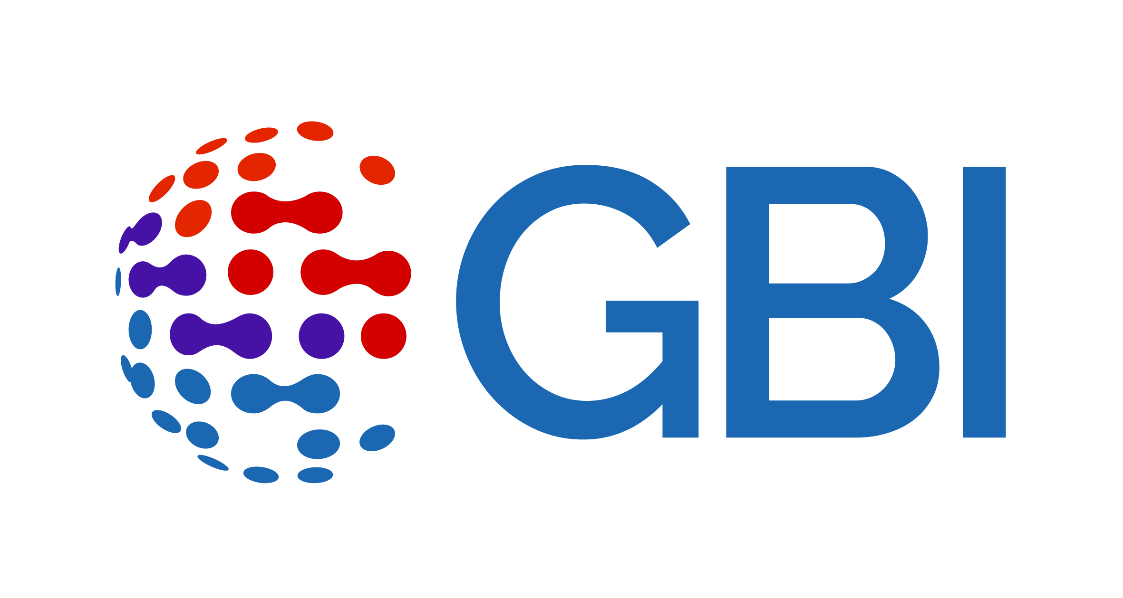

BUSINESS & HUMAN RIGHTS 101 – LEARNING RESOURCE
CEE&CA Summer Academy on Business and Human Rights 2024
The Global Business Initiative on Human Rights

Slide 2


Module 2.2
SOME FIRST STEPS:
Identifying impacts

Slide 3
Getting to know your company's human rights risks
Companies today are expected to know and show that they respect human rights in their business activities and business relationships. But how do you start?
Processes to identify and understand impacts are key to doing this. They’re a core part of the ‘know’ in ‘know and show’. And mandatory regulation continues to increase requirements.
Implementing these processes can be easier said than done. Companies can impact virtually any human right – from workplace rights to health and safety issues, discrimination, privacy, security, cultural rights and more. And they can become involved in impacts through their own activities and their business relationships. For companies with a global value chain, the task can seem overwhelming. But it doesn’t have to be.
The key is to start somewhere, and then build on that. Done well, impact assessments help you know what your company’s actual or potential human rights impacts are, so you can take steps
to address these. They can also help build trust and credibility with stakeholders.

Slide 4

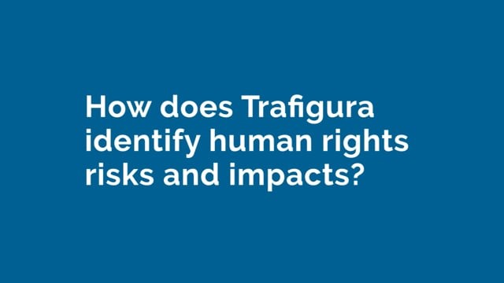
Watch these two videos of company practitioners speaking about how they identify human rights risks
Play this video direct on Vimeo here
Play this video direct on Vimeo here

Slide 5
What do processes to identify impacts look like in practice?
Ways to identify and understand impacts:
Undertake desk research to identify key risks in the company's industry and the regions where it operates.
Implement in-depth processes to identify risks and impacts connected to specific operations, products or services.
Draw on market reports, government reports and academic studies, as well as information from audits and internal grievance mechanisms.
Ways to ensure the company acts on findings:
Integrate efforts to identify impacts into business decision-making (e.g. before entering a new market or developing a new product/business).
Ensure lines of accountability for acting on the findings of impact assessment processes are clear.
Establish feedback loops between teams conducting impact assessments and those acting on the findings.

Slide 6
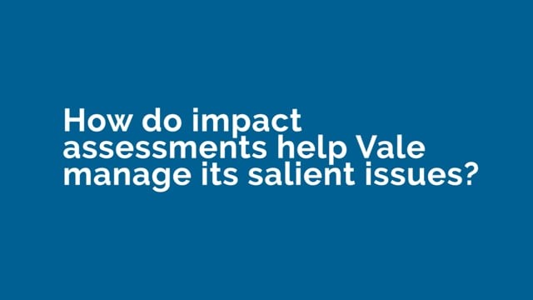
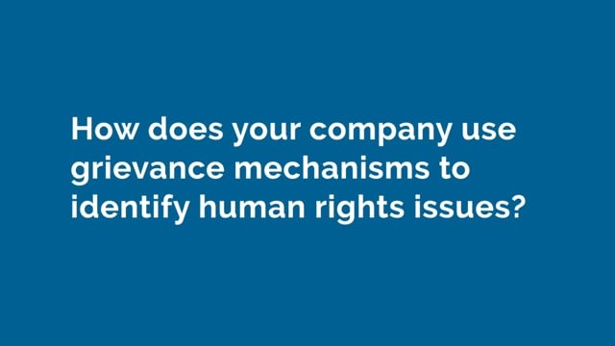
Now watch these two videos of company practitioners talking about how impact assessments and grievance mechanisms help them to identify human rights impacts
Play this video direct on Vimeo here
Play this video direct on Vimeo here

Slide 7

What do the UN Guiding Principles say about identifying impacts?
The UNGPs expect companies to take active steps to identify and understand human rights impacts that they may be involved in through their own activities and through their business relationships.
KEY GUIDANCE ON IDENTIFYING IMPACTS INCLUDES:
Assessments of human rights impacts should be undertaken prior to a new activity or relationship, major decisions or changes in the operation, in response to (or anticipation of) changes in the operating environment, and periodically throughout the lifecycle of an activity or relationship.
The purpose of processes to identify and assess adverse impacts is to understand the specific impacts on specific people, in a specific context of operations.
Companies should draw on internal and/or external human rights expertise and consult meaningfully with potentially affected groups and other relevant stakeholders.
Companies should integrate the findings of their impact assessments across relevant internal functions and processes – and take appropriate action.
→ See Guiding Principles 12, 17, 18 and 19 for more.

Slide 8
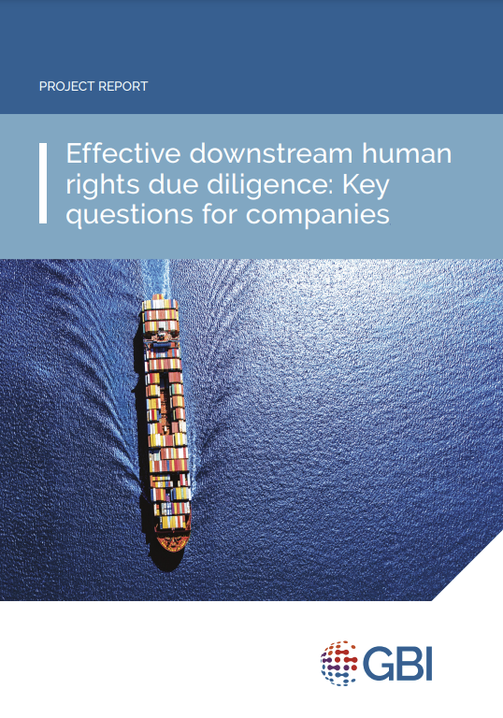
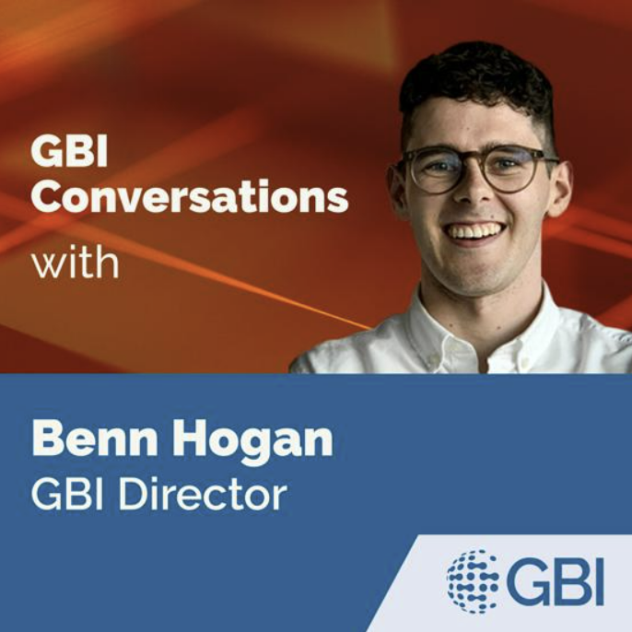

What is downstream due diligence and how can it be done effectively?
Downstream due diligence can be understood as human rights due diligence on products, services, and business relationships arising from the production phase onwards to the point of sale and beyond, placing a particular focus on how products and services will be used, and by whom. To be fully appraised of a company’s human rights risks, companies should be conducting downstream due diligence. Read more in this blog.
Download GBI’s key questions for companies on effective downstream human rights due diligence below
Listen to Benn Hogan’s podcast about effective downstream human rights due diligence

Slide 9
Insights from business practice
GBI companies have been learning what works, and what doesn’t and sharing their insights to help improve business practice. Here is a summary of some of our findings on identifying impacts. You can read the full insights here
Impact assessments are a means to an end, not an end in themselves.
There are many ways to assess impacts, and your approach should be context-specific.
You should focus on risks to people – not risks to your business.
Make sure you are using the tools and methodologies that will give you the information you need.
Civil society organisations (CSOs) can be helpful and instrumental partners, particularly where information is needed quickly, but remember to consider their safety before making requests. This is part of your due diligence on the context and situation.
Colleagues involved in impact assessments need the right knowledge and skills.
Impact assessments are only effective if you act on the findings.
Meaningful engagement with stakeholders can be challenging, but is critical.

Slide 10
BUSINESS & HUMAN RIGHTS 101 – LEARNING RESOURCE
CEE&CA Summer Academy on Business and Human Rights 2024
The Global Business Initiative on Human Rights

