Slide 1


BUSINESS & HUMAN RIGHTS 101 – LEARNING RESOURCE
CEE&CA Summer Academy on Business and Human Rights 2024
The Global Business Initiative on Human Rights

Slide 2


Module 2.3
SOME FIRST STEPS:
Dealing with grievances

Slide 3
Dealing with grievances:
Respecting human rights when things go wrong
Sometimes, things will go wrong. Even with good policies and processes in place.
How a company responds when this happens is key to whether it is - and is seen to be - respecting human rights. Stakeholders and international standards expect companies to focus on righting the wrong. Achieving a meaningful outcome – and effective remedy – for affected people. These situations also offer an opportunity for companies to build trust and deepen their relationships with key stakeholders.
Doing this well can be hard. But by taking a thoughtful approach to dealing with grievances, companies can help ensure they do right by the people affected by their business activities and meet stakeholders’ expectations.

Slide 4


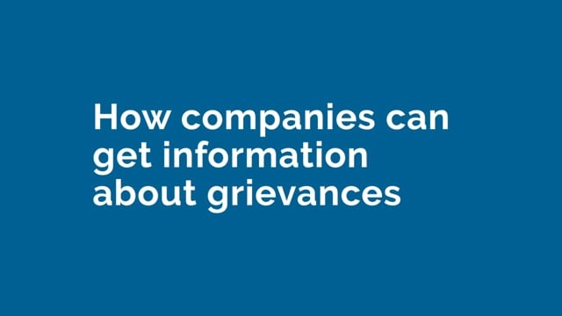
Now watch these two videos on how companies should respond to grievances and how companies can get information about grievances.
Play this video on Vimeo here
Play this video on Vimeo here

Slide 5
What does dealing with grievances look like in practice?
Ways to identify grievances:
Strengthen existing hotlines and community liaison processes, such as BASF's Community Advisory Panels.
Develop and implement new grievance mechanisms – alone or in collaboration with other stakeholders.
Build a culture of openness that empowers employees and suppliers to raise issues and concerns.
Use human rights impact assessment, transactional due diligence and audit processes to identify issues and grievances.
Ways to respond to and address grievances:
Use internal processes (including ombudspersons) to resolve grievances directly.
Collaborate with other stakeholders (including business, government and civil society) to address specific issues.
Participate in third party processes – such as OECD National Contact Point, tribunal, court and arbitration processes.
Take steps to prevent issues recurring once identified.
Appropriate processes to identify and respond to grievances will vary with context. Testing thinking and ways forward with external experts and civil society organisations can be helpful.

Slide 6

What do the UN Guiding Principles on Business and Human Rights say about grievances?
The UN Guiding Principles on Business and Human Rights expect companies to provide for or participate in remedy when they have caused or contributed to human rights harms. Additionally, where a company is instead directly linked to harms, the UNGPs note that it may still wish to play a role in remedy – even though it does not have a responsibility to do so.
KEY GUIDANCE ON DEALING WITH GRIEVANCES INCLUDES :
Companies should address adverse human rights impacts they are involved in, which requires taking adequate measures, where appropriate, for their remediation.
To make it possible for grievances to be addressed early and remediated directly, companies should establish or participate in operational-level grievance mechanisms.
Collaborative initiatives, including industry initiatives, should ensure the availability of effective mechanisms through which affected parties can raise concerns.

Slide 7
What do the UN Guiding Principles on Business and Human Rights say about grievances?
KEY GUIDANCE ON DEALING WITH GRIEVANCES INCLUDES (2/2):
To ensure their effectiveness, non-judicial grievance mechanisms should be legitimate, accessible, predictable, equitable, transparent, rights-compatible, a source of continuous learning and based on engagement and dialogue.
→ See Guiding Principles 11, 22 and 29 – 31 for more.
Importantly, whilst companies may have a responsibility to provide for or participate in remedy, States also play a role here. They have an international legal duty to ensure access to effective remedy for affected people. More information about this is set out in Pillar III of the UNGPs.

Slide 8
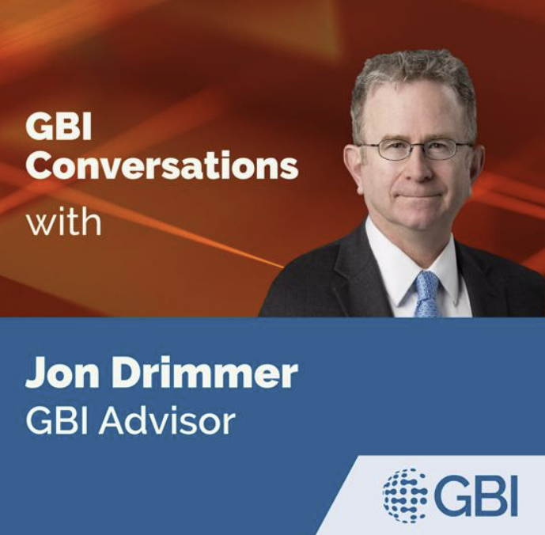

Listen to this podcast on how expectations around remedy are changing and how companies can best prepare
Expectations regarding access to remedy are hardening - is your company prepared?
Jon Drimmer, North America Advisor to the GBI discusses how expectations regarding access to remedy are hardening as a result of mandatory human rights due diligence laws, what this means for business and how to prepare.
Run time - 27 mins

Slide 9
Insights from business practice
GBI companies have been learning what works, and what doesn’t and sharing their insights to help improve business practice. Here is a summary of some of our findings on dealing with grievances. You can read the full insights here
Companies deal with grievances in many different ways.
Grievance mechanisms can be evolved and scaled over time.
It can be helpful to coordinate approaches to grievance across the value chain.
Strengthening a grievance mechanism can result in more grievances being raised.
Understanding power disparities is key to dealing effectively with grievances.
It can be hard for companies to communicate about how they have responded to a particular grievance.

Slide 10
BUSINESS & HUMAN RIGHTS 101 – LEARNING RESOURCE
CEE&CA Summer Academy on Business and Human Rights 2024
The Global Business Initiative on Human Rights

