Slide 1


BUSINESS & HUMAN RIGHTS 101 – LEARNING RESOURCE
CEE&CA Summer Academy on Business and Human Rights 2024
The Global Business Initiative on Human Rights

Slide 2


Module 3.1
EMBEDDING RESPECT FOR HUMAN RIGHTS IN A COMPANY:
Driving change, raising awareness, training and capacity building

Slide 3

Driving change
BEING AN EFFECTIVE CHANGE AGENT
For most companies, implementing respect for human rights will be a journey.
To manage human rights challenges effectively, a company needs to understand how different parts of its business and its value chain can have a negative impact on people, and then take action. Putting this into practice requires more than just developing good policies and processes. It’s also about the people who will inform, approve and implement them. To ensure that human rights issues are managed effectively, business practitioners need to get people and teams across the business invested and working together.
Driving change amongst different people, teams and functions – and bringing them with you – may seem like a challenge. And it is. Practitioners need to be team players, drivers and a leaders. But by building these capabilities, they can have a profound and sustained impact to support their company to meet its responsibility to respect human rights. And that, in turn, is good for the business, too.
Watch this video before moving on:
Play this video on Vimeo here

Slide 4


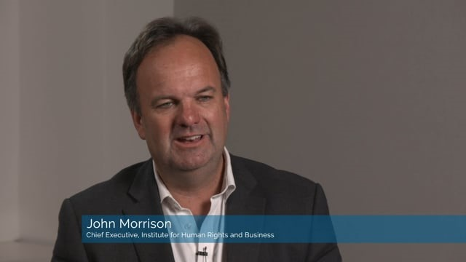
Raising Awareness, Training and Capacity Building
STRENGTHENING AWARENESS, KNOW-HOW AND COMMITMENT
Watch this video first:
On any given day, millions of employees around the world can impact human rights, for better or worse.
Executives making decisions about strategic direction and budget allocation. Procurement managers choosing to buy from this supplier, or that one. Programmers training the latest AI tool. Security staff responding to threats. Lawyers advising on a deal. Human resources specialists. Marketing executives. Community liaison officers. Factory supervisors.
Any of these employees could inadvertently involve their company in an adverse human rights impact if they're not aware of the company's commitments and policies. If they don't understand what these mean for their role. Or if they simply don't take it seriously.
But with training and commitment, they can help identify and respond to issues early, and find better ways to operate. So, it's critical to figure out who needs to know what. And then build knowledge and commitment to drive changes in practice and culture.
Play this video on Vimeo here
NB: If you already watched this video in Module 1.0, you can either watch it again as a refresher or skip to the next section.
Play this video on Vimeo here

Slide 5
What does training and capacity building look like in practice?
Ways to raise awareness and provide training across the company:
Incorporate a human rights module in mandatory training and refresher courses, for example on business ethics or codes of conduct.
Provide in-depth training to all new employees, communicating clearly the company's commitment and incorporating relevant case studies.
Organise a “Human Rights Day” (or month) to initiate discussions, accompanied by newsletters, videos and posters.
Ways to build deeper capacity amongst key managers and teams:
Provide mandatory training that focuses on specific skills and knowledge, and uses real-life case studies to demonstrate relevance.
Use interactive formats to deepen learning opportunities, such as cross-functional role plays to strengthen teamwork and know-how.
Make the most of due diligence activities (e.g., regional workshops to identify salient issues) to increase understanding across the business.

Slide 6
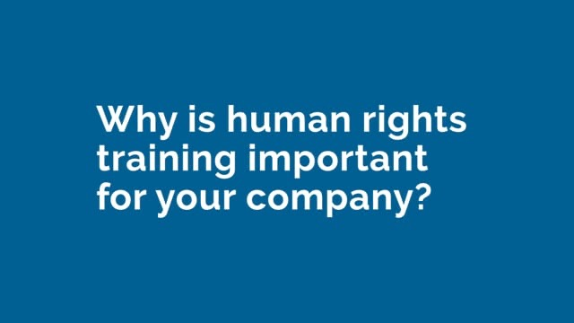
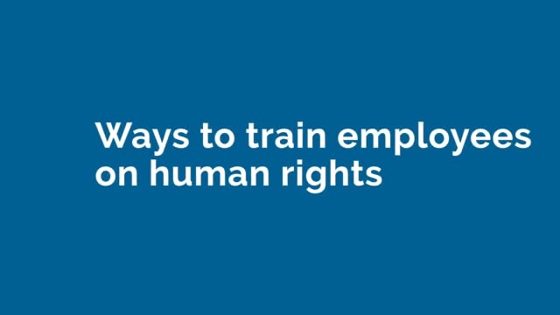
What does training and capacity building look like in practice?
Watch this video first:
Ways to enhance access to tools and guidance:
Develop guides that offer plain language information and examples, such as TotalEnergies’ Human Rights Guide and Vale’s Human Rights Guide.
Host an online portal with videos, news, guidance and tools, such as this page of The Coca-Cola Company's website.
Release a mobile device app with tools and resources, such as the app developed by The Coca-Cola Company (IOS and Android).
Play this video on Vimeo here
And this video next:
Play this video on Vimeo here

Slide 7

What do the UN Guiding Principles say about training?
The UNGPs, recognise the importance of strengthening awareness and knowledge.
KEY GUIDANCE ON AWARNESS RAISING, TRAINING AND CAPACITY BUILDING INCLUDES:
A company’s responsibility to respect extends across all internationally recognised human rights. Companies need to build the capacity to identify, address and communicate about issues related to any internationally recognised human right.
Employees need to be aware of the company’s policy commitment and receive relevant training and operational guidance. A company’s human rights policy statement – and related policies, processes and lines of accountability – need to be communicated clearly.
Companies should build the capacity of employees to identify and address human rights risks. To carry out effective human rights due diligence, employees in relevant functions will need specific knowledge and capacity. You may need to “translate” human rights-related concepts into operational language, and ensure employees know where to find more information.
→ See Guiding Principles 12 and 16 - 20 for more information.

Slide 8

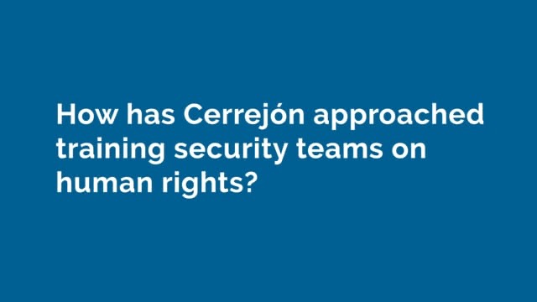
What do the UN Guiding Principles say about training?
Security teams should also be trained on human rights.
Watch this video to learn more about how Cerrejón approached training their security teams on human rights.
Play this video on Vimeo here

Slide 9
Transforming corporate cultures
Efforts to raise awareness, train and build capacity are key to implementing effective policies and processes to manage human rights risks. Importantly, these efforts are also critical to achieving the deeper transformation in corporate cultures needed to include respect for human rights in how business is conducted.
PLACES TO START INCLUDE:
Improving tracking, monitoring and evaluation
A key challenge for business practitioners is knowing how effective training initiatives are. Are employees following their training? Have they really understood and internalised key concepts and guidance? Do they feel empowered to use their knowledge in practice? Do they get the importance of doing so? Advancing practice in this area seems key to building on what works and improving what doesn’t.

Slide 10
Transforming corporate cultures
PLACES TO START INCLUDE:
Overcoming the challenges of scale
Another challenge to overcome - particularly for large and multinational enterprises - is finding practicable ways to reach vast numbers of employees. And to do so where those employees are based in many different countries, with different languages and cultures. Some companies are working to train "networks of champions" who can cascade know-how within their region or part of the business. Others use online platforms to connect different parts of the business and disseminate information and insights. These initiatives are valuable, and there are real opportunities (and need) to build on them.

Slide 11
Insights from business practice
You can find more about these insights on the GBI website
Determine who needs to know what - and revisit this over time.
Leverage existing training and capacity building processes.
Use language that will resonate with and be understood by the audience.
Case studies can help make human rights real and relevant to colleagues.
Be practical and creative to strengthen commitment, ownership and teamwork.
Multipliers can help scale efforts to raise awareness and know-how.

Slide 12
BUSINESS & HUMAN RIGHTS 101 – LEARNING RESOURCE
CEE&CA Summer Academy on Business and Human Rights 2024
The Global Business Initiative on Human Rights

