Slide 1


BUSINESS & HUMAN RIGHTS 101 – LEARNING RESOURCE
CEE&CA Summer Academy on Business and Human Rights 2024
The Global Business Initiative on Human Rights

Slide 2


Module 3.2
EMBEDDING RESPECT FOR HUMAN RIGHTS IN A COMPANY:
Engaging effectively to address issues in the supply chain

Slide 3

Engaging effectively to address human rights issues in the supply chain
Companies are under increasing pressure to demonstrate that they are managing human rights issues in their supply chains effectively. But how do you go about effectively managing human rights risks in your supply chain?
Pressure from investors, customers and other stakeholders – as well as emerging mandatory reporting and due diligence requirements – are focusing minds on supply chain risk management. The Covid-19 pandemic, too, has highlighted the vulnerabilities of workers and other groups in global value chains. Clearly, more needs to be done.
But there is less consensus as to how best to approach these challenges – or what good looks like. Audit processes can provide useful information and indicators of human rights risks. But we know they have very real limitations. Audits should support the company to do better – not just to feel better. The process should be about impacts on people, not optimising bureaucracy. It’s about what works for your company, what is effective and being mindful that the goal is to address shared challenges with suppliers. Increasingly, forward-looking companies are also exploring beyond audit approaches.

Slide 4
What does managing supply chains look like in practice?
WAYS TO IDENTIFY HUMAN RIGHTS RISKS IN THE SUPPLY CHAIN:
Undertake a high-level mapping of key human rights risks in the company’s supply chain to help prioritise further due diligence.
Undertake a ‘deep dive’ into higher risk parts of the supply chain – based on issues, region or product.
Incorporate human rights considerations into audit processes and remediation/action plans.
WAYS TO ENGAGE WITH SUPPLIERS ON HUMAN RIGHTS ISSUES:
Use contractual negotiations and agreements to set expectations and gauge a partner’s understanding of key issues.
Ensure the company will have access to information about human rights issues – and that concerns will be heard.
Think proactively about opportunities to engage with peers to promote common expectations.
WAYS TO ADDRESS HUMAN RIGHTS ISSUES THAT ARISE IN THE SUPPLY CHAIN:
Discuss the situation with the supplier(s) and other relevant stakeholders to understand the issues and develop a response.
Offer training and capacity-building support to the supplier and build common expectations and ways of working.
Work with suppliers and other relevant stakeholders to solve problems.

Slide 5
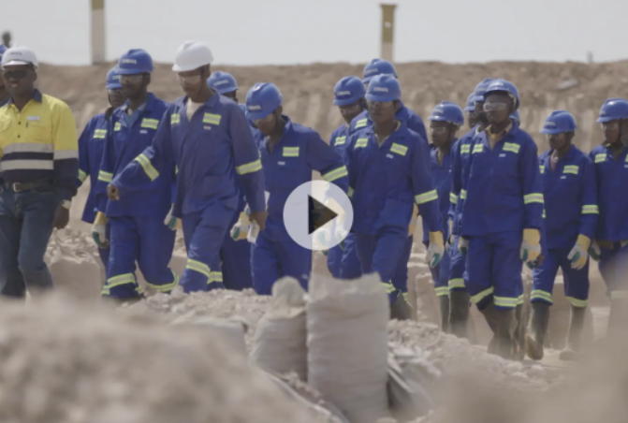
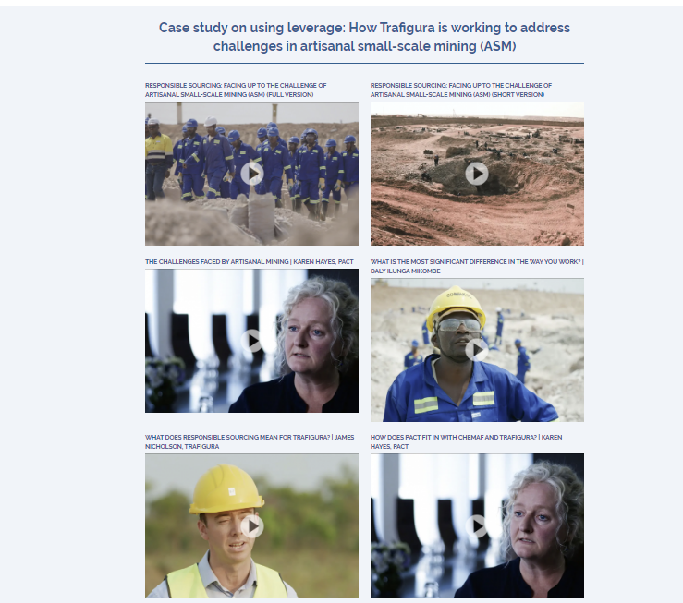

Why does a company need to understand its supply chain to source responsibly?
Explore one company’s journey and how they faced challenges in their supply chain by watching the first video and explore more through the videos on this page of GBI Business Practice Portal (click the images to access the pages)

Slide 6

What does it mean to go beyond audits?
Play this video on Vimeo here

Slide 7

What do the UNGPs say about managing supply chains?
The UN Guiding Principles on Business and Human Rights, or UNGPs, provide guidance relevant to managing human rights risks in the supply chain.
Importantly, the UNGPs adopt an expansive definition of “business relationships” that goes beyond direct, first-tier and contractual relationships. This definition includes relationships with business partners, entities in a company’s value chain and entities directly linked to the company’s operations, products or services.
See the Commentary to Guiding Principle 13 for more.
ADDITIONAL KEY GUIDANCE INCLUDES:
Companies should avoid contributing to adverse impacts and use leverage to seek to prevent or mitigate those that are directly linked to their operations, products or services by their business relationships.
Human rights due diligence should be initiated as early as possible in the development of a new relationship, because human rights risks can be increased or mitigated at the stage of setting expectations and structuring contracts.
Companies should identify general areas where the risk of adverse impacts is most significant and prioritise these for human rights due diligence where the number of entities in the supply chain makes it unreasonably difficult to conduct due diligence across all entities.
Assessments of human rights impact should be undertaken prior to entering into a new relationship and periodically through the life of the relationship.
→ See Guiding Principles 13 and 17 – 19 for more.

Slide 8
Insights from business practice
GBI COMPANIES HAVE BEEN LEARNING WHAT WORKS, AND WHAT DOESN’T AND SHARING THEIR INSIGHTS TO HELP IMPROVE BUSINESS PRACTICE. HERE IS A SUMMARY OF SOME OF OUR FINDINGS ON IDENTIFYING IMPACTS:
Prioritise effectively to overcome challenges of scale.
Embed human rights in existing systems.
Use audits but go beyond tick-box exercises. Learn from and act on the findings.
Interviews and conversations can deepen understanding of realities on the ground.
Worker voice tools are not a panacea, but can be valuable to boost visibility of issues.
Look at the whole system to understand the challenges and identify smart actions.
Collaborate with business partners to deliver training across the supply chain.
Use leverage to drive change across the supply chain.

Slide 9
BUSINESS & HUMAN RIGHTS 101 – LEARNING RESOURCE
CEE&CA Summer Academy on Business and Human Rights 2024
The Global Business Initiative on Human Rights

