Slide 1


BUSINESS & HUMAN RIGHTS 101 – LEARNING RESOURCE
CEE&CA Summer Academy on Business and Human Rights 2024
The Global Business Initiative on Human Rights

Slide 2


Module 3.3
STAKEHOLDERS:
Engaging effectively with stakeholders

Slide 3

Engaging effectively with people and organisations
There is a lot of guidance and expertise available to help companies implement respect for human rights. But there is no single blueprint, so each company has to develop its own approach, based on authoritative international standards. And the company needs to continuously review and adapt its approach to reflect changes in its human rights risks, operating environment and business.
To do this well, companies need to engage effectively with relevant people and organisations within the business and beyond. This process of engaging with stakeholders is key to identifying and understanding human rights risks, testing and getting feedback on actions the company is taking, and remedying impacts when they occur.
Stakeholder engagement can be hard. It requires time, openness and trust-building – often with stakeholders who may be critical of the company. But it is key to respecting human rights. Done well, good stakeholder engagement will help strengthen a company’s efforts to know what its human rights risks are – and to show that it is taking effective steps to manage them.

Slide 4
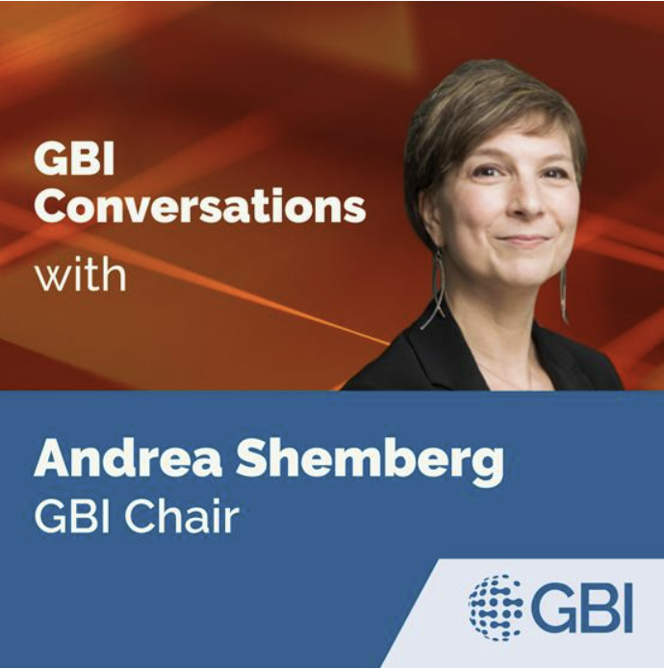

Why meaningful engagement with stakeholders is key to managing legal risk
Andrea Shemberg, Chair of the Global Business Initiative on Human Rights discusses why meaningful engagement with stakeholders is key to implementing effective human rights due diligence – and to managing legal risk – and what ‘meaningful’ looks like.
Play this podcast on Apple Podcasts here
Run time - 26 minutes

Slide 5
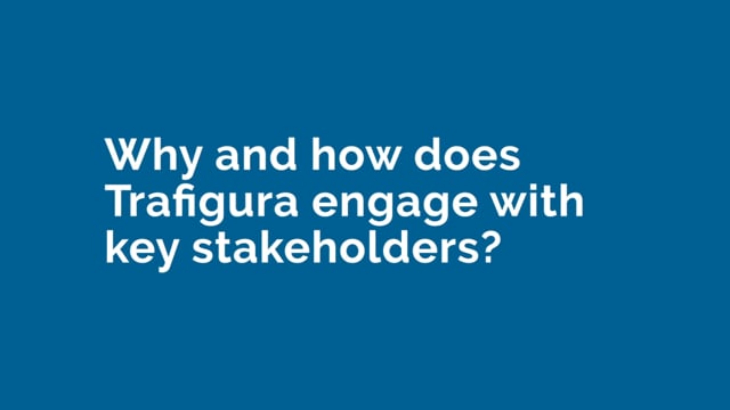
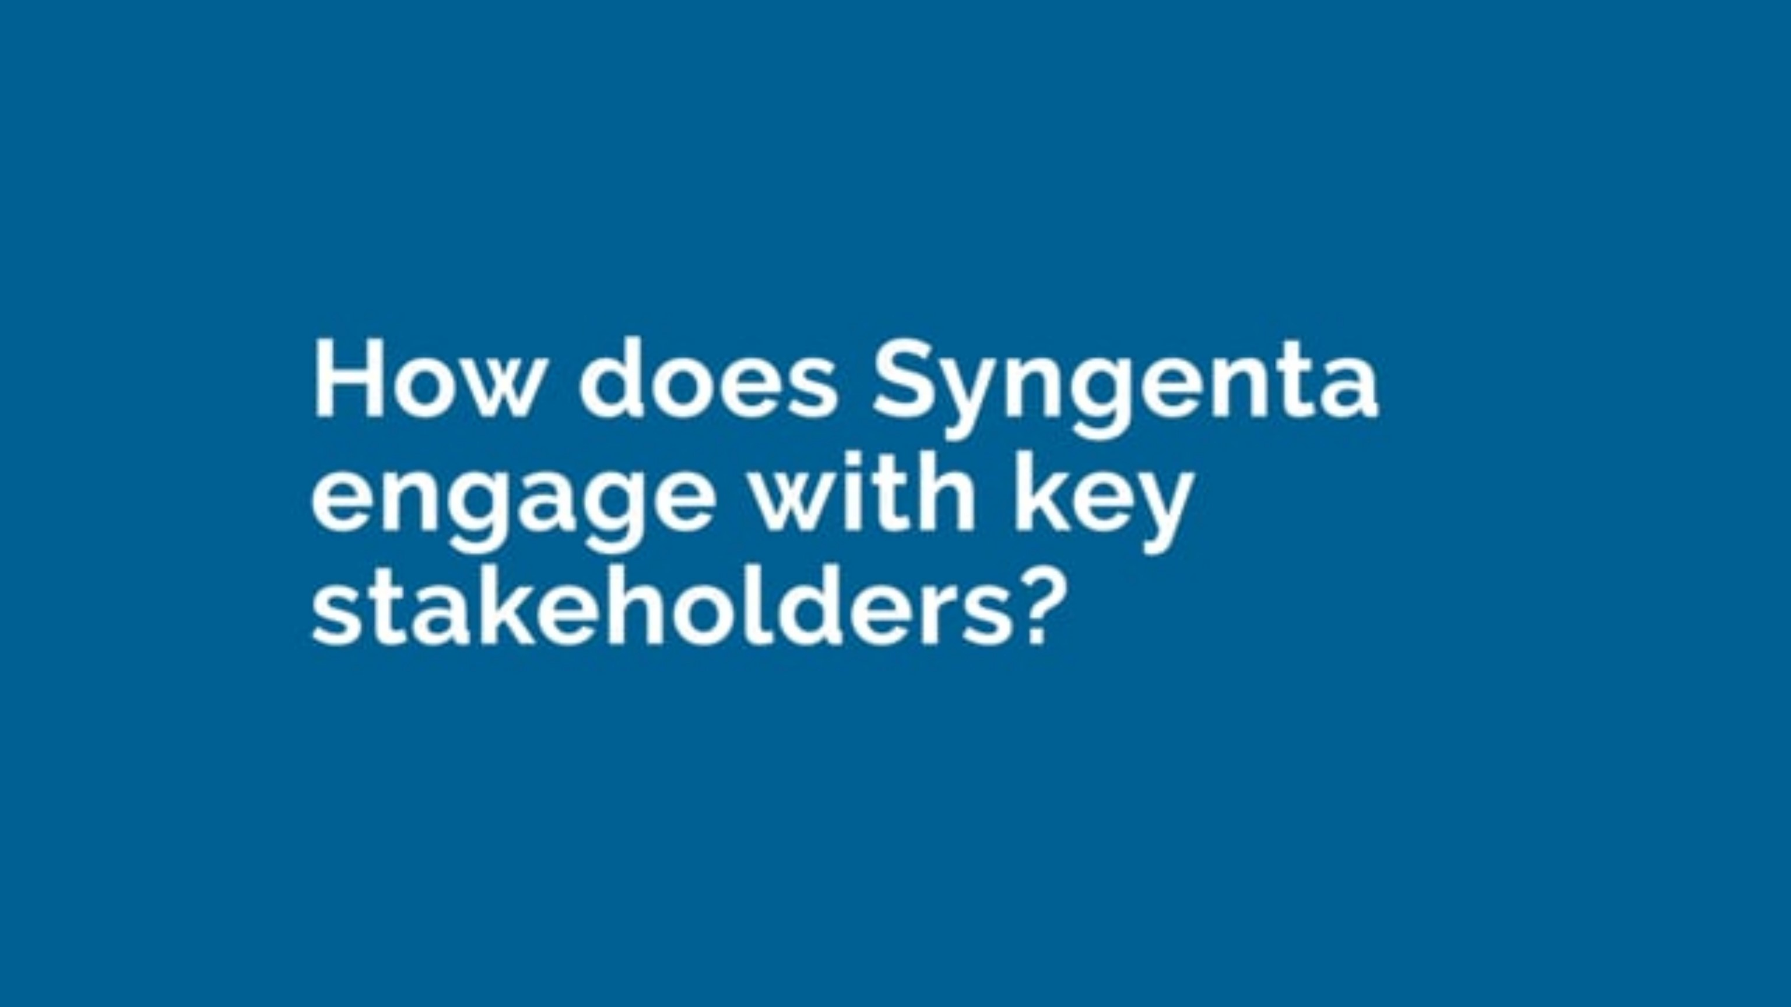
How are companies managing stakeholder engagement in practice?
Watch these two videos and note down your insights

Slide 6
What does stakeholder engagement look like in practice?
There are many ways a company can engage with stakeholders.
Ways to get information about human rights risks and impacts include:
Work with relevant colleagues across the business to map potential risks and explore how to assess and respond to adverse impacts.
Engage with potentially affected people – including local communities – when working to identify impacts.
Participate in industry and multistakeholder groups to exchange information about complex challenges.
Ways to share and get feedback on a company’s approach to managing human rights risks include:
Establish a stakeholder advisory panel comprising representatives of diverse groups to provide feedback at regular intervals.
Reach out to external experts to test thinking and proposed actions.
Engage with government bodies, investors, civil society representatives and others to understand expectations and share progress.
Ways to remediate impacts and deal with grievances include:
Engage with potentially affected groups and experts to strengthen the design and implementation of grievance processes.
Establish a forum for ongoing dialogue with local communities, such as BASF’s Community Advisory Panels.
Work with human rights defenders to ensure affected people know about the company’s grievance processes.

Slide 7

What do the UN Guiding Principles say about engaging stakeholders?
The UNGPs expect companies to take active steps to engage with stakeholders as they work to implement respect for human rights.
Processes to identify and assess adverse human rights impacts should involve meaningful consultation with potentially affected groups and other relevant stakeholders, taking into account language and other potential barriers to effective engagement.
Companies should pay special attention to groups or individuals at heightened risk of vulnerability or marginalisation, and be aware that different risks may be faced by women and men.
Where direct consultation is not possible, companies should consider reasonable alternatives, such as consulting credible independent experts like human rights defenders.
Operational-level grievance mechanisms should be based on engagement and dialogue, consulting the stakeholder groups for whose use they are intended on design and performance.
See Guiding Principles 18 – 20, 29 and 31 for more.

Slide 8
Insights from business practice
You can explore these insights more on the GBI website.
Good stakeholder engagement is key to respecting human rights
Know which stakeholders the company should engage with – and when to do so
Be attentive to the design of an engagement
Find effective ways to get meaningful input from diverse stakeholders
Consider formalising a stakeholder engagement panel
Don’t overlook internal stakeholders – such as key colleagues and senior leaders

Slide 9
BUSINESS & HUMAN RIGHTS 101 – LEARNING RESOURCE
CEE&CA Summer Academy on Business and Human Rights 2024
The Global Business Initiative on Human Rights

