Slide 1


BUSINESS & HUMAN RIGHTS 101 – LEARNING RESOURCE
CEE&CA Summer Academy on Business and Human Rights 2024
The Global Business Initiative on Human Rights

Slide 2


Module 4.2
LEGAL & POLICY UPDATES 2024:
EU Corporate Sustainability Reporting Directive
(CSRD)
The Corporate Sustainability Due Diligence Directive (CSDDD)
The European Forced Labour Regulation

Slide 3
What are the current trends in the business and human rights regulatory landscape?
In recent years, there has been a push to move beyond voluntary reporting requirements, that started with:
1. Modern Slavery Statements, to hardened requirements that companies conduct human rights due diligence.
2. The French Duty of Vigilance law in 2017. In 2021, Germany also passed its supply chain due diligence act.
3. The European Union have also put forward several directives requiring companies to conduct and report on human rights and environmental due diligence.
Partly, these have come as a result of the EU Green Deal.
We will explore three of those directives in this module to understand what these hardened requirements for companies to conduct human rights due diligence will mean for companies.

Slide 4
Work through this presentation on the
Corporate Sustainability Reporting Directive (CSRD) and the
Corporate Sustainability Due Diligence Directive (CSDDD)
Keep in mind what the requirements of the UNGPs are for companies

Slide 5
EU Corporate Sustainability Reporting Directive (CSRD)

Slide 6

Corporate Sustainability Reporting Directive: Entry into force
General
(EU companies)
Sector-specific
Non-EU companies
ESRS adopted European Commission
30 June 2023
30 June 2026
30 June 2026
Legislation applies
1 Jan 2024
1 Jan 2027
1 Jan 2028
Reports published
2025
2028
2029

Slide 7
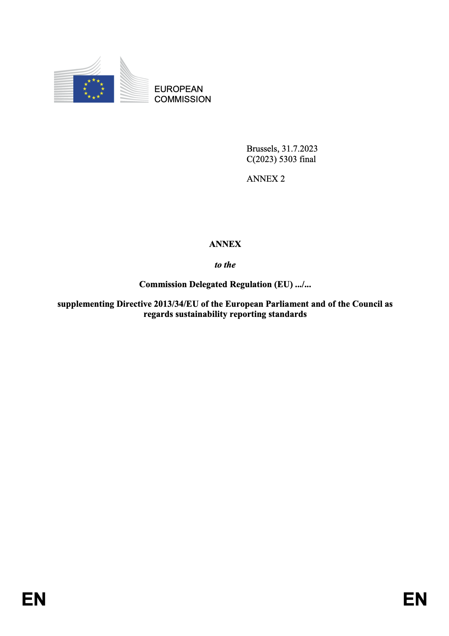

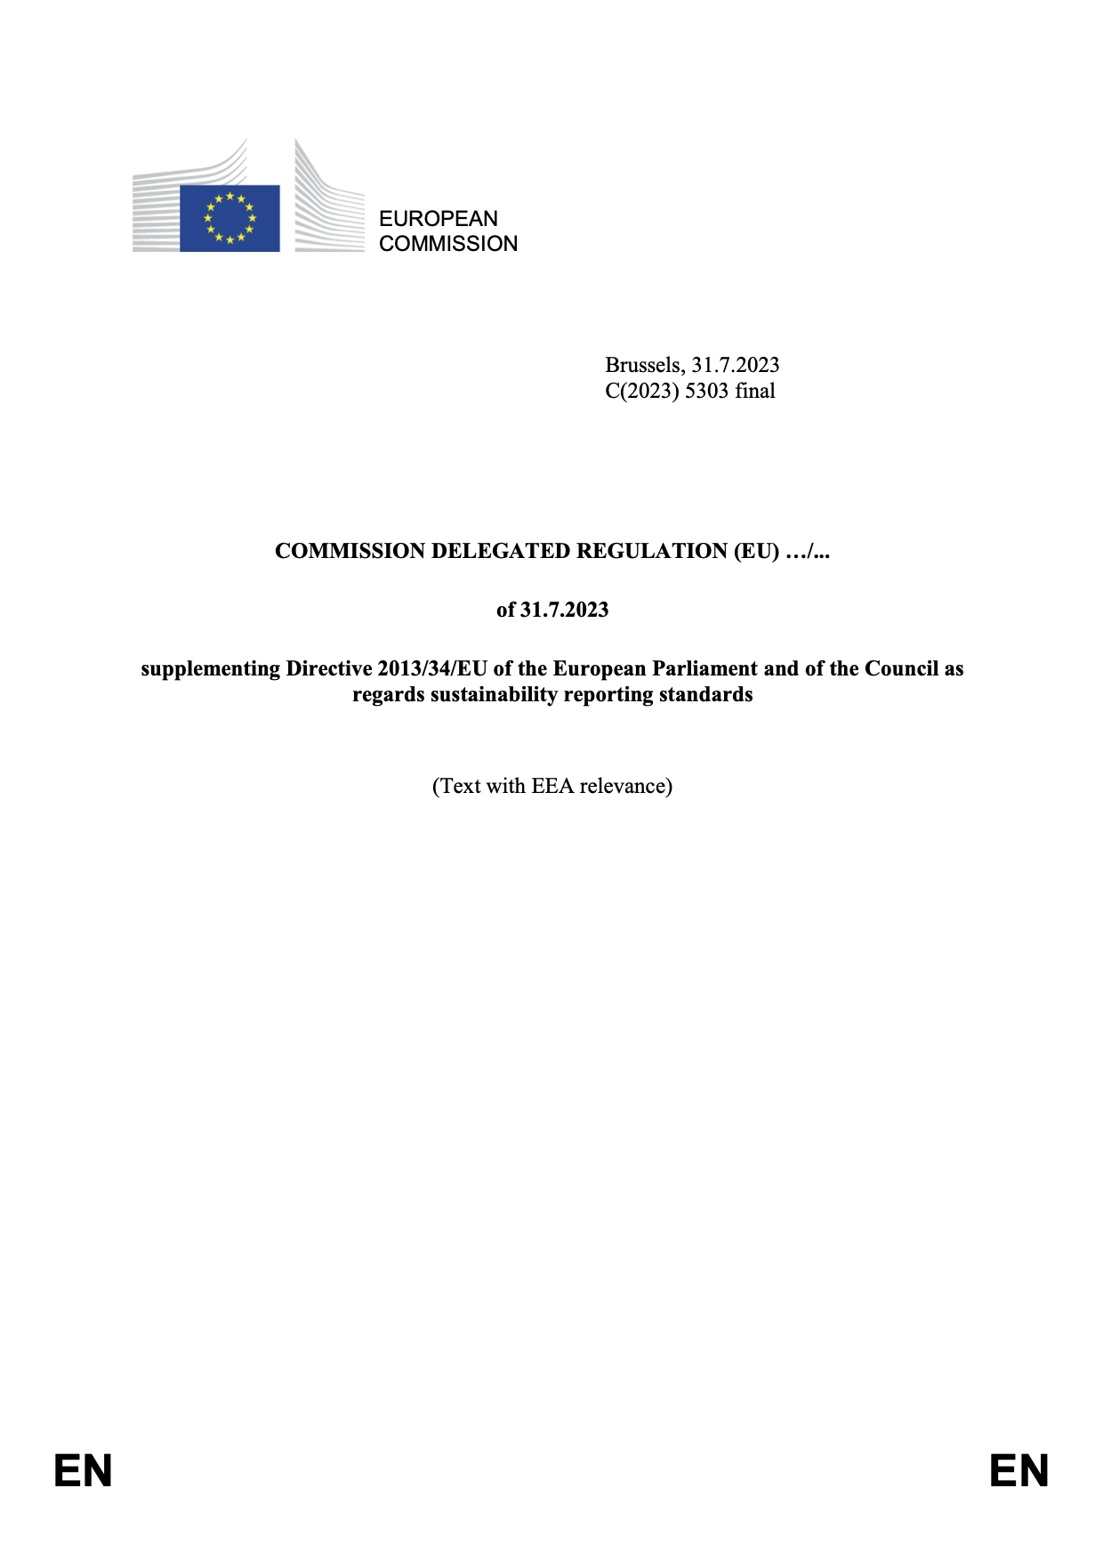
New European standards
European Sustainability Reporting Standards
ESRS 1 General requirements
ESRS 2 General disclosures
ESRS E1 Climate change
ESRS E2 Pollution
ESRS E3 Water and marine resources
ESRS E4 Biodiversity and ecosystems
ESRS E5 Resource use and circular economy
ESRS S1 Own workforce
ESRS S2 Workers in the value chain
ESRS S3 Affected communities
ESRS S4 Consumers and end-users
ESRS G1 Business conduct
European Sustainability Reporting Standards
Sector-specific [on hold]
Oil and Gas
Coal, Quarries and Mining
Road Transport
Agriculture, Farming and Fisheries
Motor Vehicles
Energy Production and Utilities
Food and Beverages
Textiles, Accessories, Footwear and Jewellery

Slide 8





New European standards: Double materiality
Impact materiality
A sustainability matter is material from an impact perspective when it pertains to the company’s material actual or potential, positive or negative impacts on people or the environment over the short-, medium- and long-term time horizons.
An expansion of traditional (accounting) materiality.
May derive from past events or future events and may have effects in relation to financial assets and liabilities and ‘capitals’
Business relationships are relevant.
Combination of likelihood and the size of the potential financial effects
Starting point.
Cause, contribute and directly linked.
Upstream and downstream value chain.
Informed by due diligence: UNGPs and OECD RBC Guidelines.
Severity (scale, scope, irremediable character) and likelihood.
Financial materiality
A sustainability matter is material from a financial perspective if it triggers or may trigger material financial effects on the company.

Slide 9
EU Corporate Sustainability Due Diligence Directive (CS3D)

Slide 10
Scope
EU and non-EU companies that enter into franchising or licensing agreements in the EU will need to implement the CS3D by 2029.
Financial sector is excluded. May be reviewed at a later date.
.

Slide 11
Obligations: Due diligence
1. Carry out risk-based due diligence on actual and potential adverse impacts on the environment and human rights for their business and its chain of activities.
  As part of their due diligence, companies should carry out meaningful engagement including a dialogue and consultation with affected stakeholders.
2. Seek to prevent or mitigate identified adverse impacts. If a business partner refuses to cooperate, there is an obligation, as a last resort, to terminate the business relationship.

Slide 12
Obligations: Climate transition plan
3. Adopt and put into effect through best efforts a transition plan for climate change mitigation
compatible with a 1.5ºC pathway. The transition plan should include:
Time-bound targets related to climate change for 2030 and in five-year steps up to 2050 based on conclusive scientific evidence;
A description of decarbonisation levers identified and key actions planned to reach these time-bound targets;
An explanation and quantification of the investments and funding supporting the implementation of the transition plan;
A description of the role of the administrative, management and supervisory bodies.

Slide 13
Administrative enforcement and civil liability
Administrative regime
National Supervisory Authorities
Power to carry out investigations related to compliance with obligations. Penalties: Details to be determined by national legislation. Member states must set a maximum penalty of at least 5% of net turnover. Relevant authority: In country of (parent) registration or, for non-EU companies, in country with branch that has largest proportion of EU turnover. Potential for link to public procurement.
Judicial regime
Civil liability
Time limit: Five years to bring a claim. Standing: Those impacted, including trade unions or civil society organisations acting on behalf of affected people. Limits on disclosure of evidence, injunctive measures, and cost of the proceedings for claimants. Claims will follow national procedures in all other respects.

Slide 14
What is not included
Directors’ duties: The proposal from the European Commission would have established a duty for directors of EU companies to set up and oversee the due diligence actions and to adapt the corporate strategy to take into account the identified adverse impacts and adopted due diligence measures. This has been deleted from the final text.
Downstream due diligence: Downstream is limited to distribution, transport and storage carried out by partners on behalf of the company.
Inclusion of the financial sector: The financial sector was removed from the scope of the directive, but their inclusion will be considered later (as soon as possible in the new mandate).

Slide 15
Resources and guidance
Model Contractual Clauses: The EU Commission will issue voluntary model contractual clauses within 30 months of the directive going into force.
Guidance: The EU Commission will release general and sector specific guidance.
Accompanying measures: A range of other supporting measures, including websites, platforms or portals will be developed to provide information and support to companies and their partners.
Single helpdesk: The EU Commission will establish a single helpdesk through which companies can find information and support.

Slide 16
Relation to the Corporate Sustainability Reporting Directive
One report: For companies already reporting under the CSRD, the reporting requirement of the CS3D will be met. Companies will need to describe how they implement due diligence under the CS3D.
Transition plans: If a company is already submitting one transition plan for the CSRD, they do not need to submit another on the CS3D. The CSRD requires companies to consider and report on the human rights impacts of their transition plan activities.
Downstream: Under the CSRD, materiality assessments include full value chain, both upstream and downstream.

Slide 17
Next steps
May 2024: Council of the European Union approved legislative text
July 2024: Directive published in the Official Journal of the European Union
+ 2 years: National implementing legislation must be adopted by each of the 27 EU member states. Obligations applicable for EU companies (i.e. 2027).
+ 2 years: Obligations applicable for non-EU companies

Slide 18


Now listen to these two podcast to hear some analysis on the CSDDD and how other regions are viewing this and other regulatory developments
The CSDDD: An analysis for business practitioners
The CSDDD: perspectives from southeast asia

Slide 19
Work through this presentation on the
EU Forced Labour regulation
Again, keep in mind what the requirements of the UNGPs are for companies

Slide 20


The EU Forced Labour Regulation
Watch this video on Vimeo here
Captions available on this video. Click to activate

Slide 21

Watch this video and note down the key insights on how practitioners can evaluate regulatory measures
Watch this video on Vimeo here
Captions available on this video. Click to activate

Slide 22
BUSINESS & HUMAN RIGHTS 101 – LEARNING RESOURCE
CEE&CA Summer Academy on Business and Human Rights 2024
The Global Business Initiative on Human Rights

