Slide 1


BUSINESS & HUMAN RIGHTS 101 – LEARNING RESOURCE
CEE&CA Summer Academy on Business and Human Rights 2024
The Global Business Initiative on Human Rights

Slide 2


Module 4.2
MENTAL HEALTH
Dealing with complex and sensitive impacts

Slide 3
Mental health: topic content warning
Please note that this module may touch on subjects and provide images that some people may find difficult or triggering.
If you do not wish to review this module, you do not have to.
Stop if you start the module and do not wish to continue.
If you choose to review this module and are affected by anything, please seek professional support and advice.

Slide 4
What is the link between mental health and business and human rights?
Importance of using a business and human rights lens for company mental health policies
COVID-19 pandemic highlighted the need for attention to mental health impacts of companies
Mental health is a human right and should be respected within business operations with other human rights
Conditions of mental ill-health classified vulnerable in international human rights law
Notes:
This module will provide a brief overview of business impacts on the right to mental health and how this links with companies’ business and human rights commitments.
Importance of using a business and human rights lens for company mental health policies
To date, for those companies which do have any kind of formalised approach on mental health, most are not using the lens of business and human rights and the UNGPs to guide their approach, either internally in the workplace or externally to look at and assess any possible negative mental health impacts of their products, operations and services.
And for those who aren't, there's potentially a big gap, as there is a lot which mental health can reveal about the human rights impacts of a company, as well as there being positive impacts of getting mental health right for rights holders.
Whilst this can be a challenging area for human rights practitioners in companies as it can be broad-ranging, complex and sensitive, it can also be an area of practice where it is easier for them to gain traction with colleagues and their board. With mental health, whilst it's difficult to sometimes identify what the ultimate risk or impact might be, it's really easy to articulate how this is a risk to people. And so in terms of understanding and of communicating the human rights side of this, it should quite quickly and easily resonate with colleagues and company boards.
COVID-19 pandemic highlighted the need for attention to mental health impacts of companies
The lack of attention by companies and their not adding a human rights lens to their mental health risks came into very sharp focus during COVID-19 pandemic, and we now know that there are many compelling reasons to involve human rights practitioners in discussions on mental health.
Mental health is a human right and should be respected within business operations with other human rights
Conditions of mental ill-health classified vulnerable in international human rights law
Since mental health is a human right, it should be considered under the responsibility to respect all human rights within a business' operations. So, it should very much be on the radar of every human rights practitioner. Companies need to be aware of conditions of mental ill-health that may mean a rightholder is classified as vulnerable under international human rights law, and so afforded extra protections.

Slide 5
What is the business case for companies to look at mental health as part of business and human rights?
Increasing recognition of mental health issues globally, with significant issues around workplace-related stress
Governments starting to regulate and guide companies on mental health due to strain on public resources
Poor mental health impacts companies’ operations, reputations and presents challenges for effective remedy from other human rights harms

Slide 6
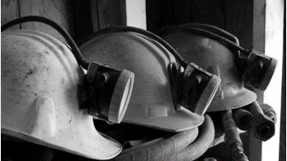
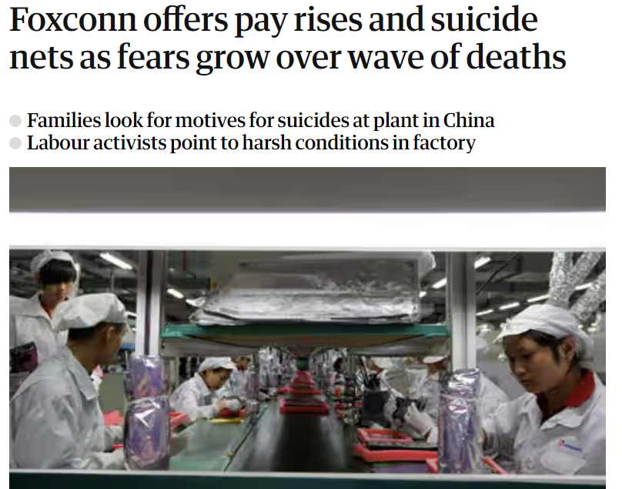


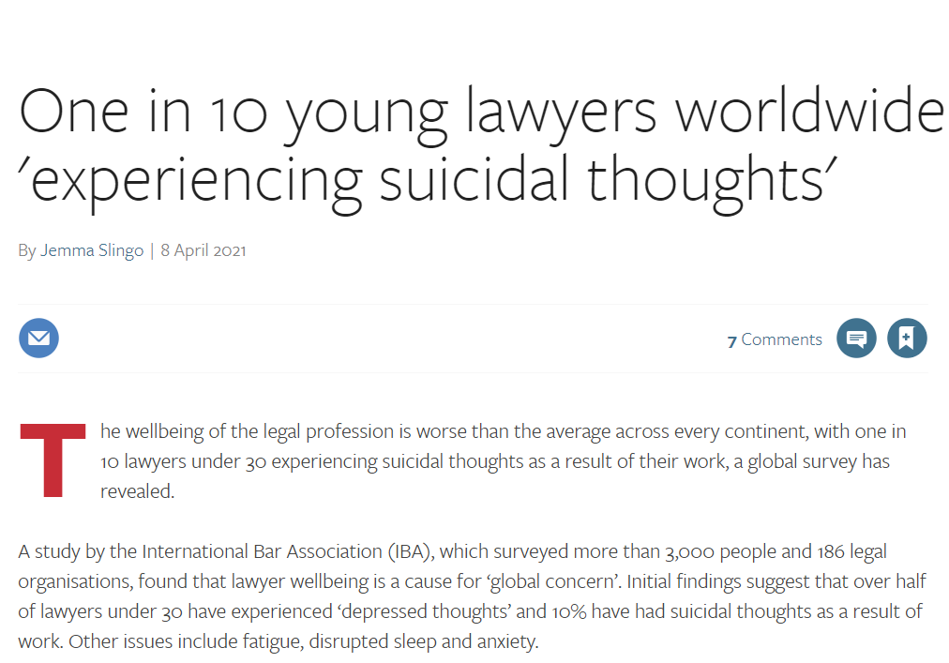
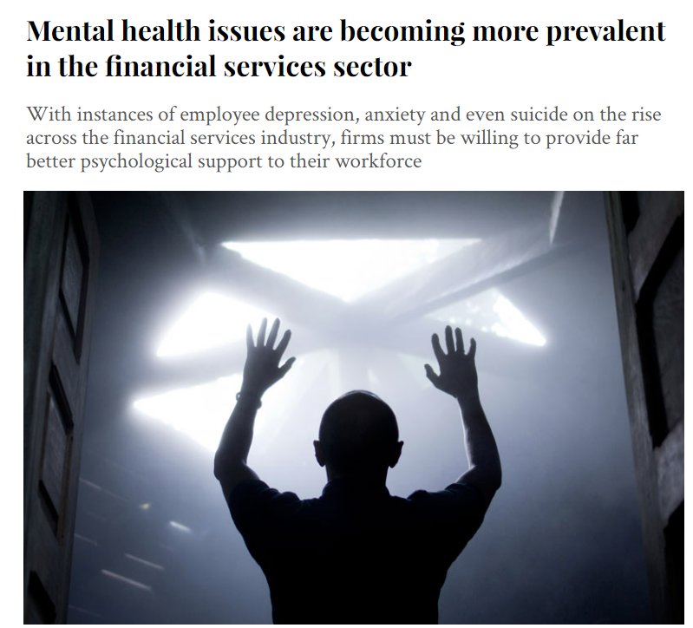
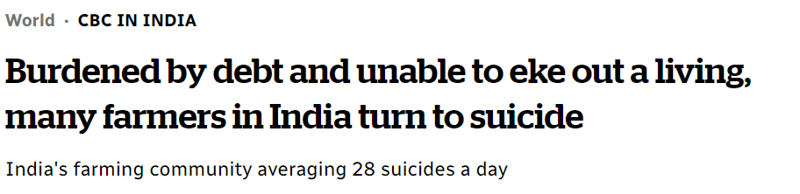
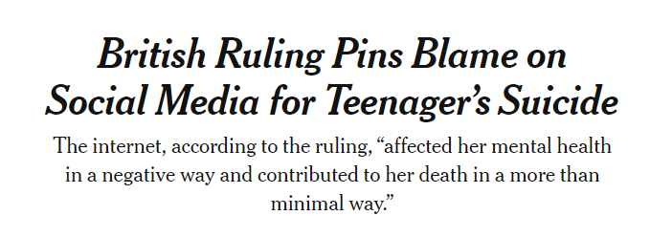
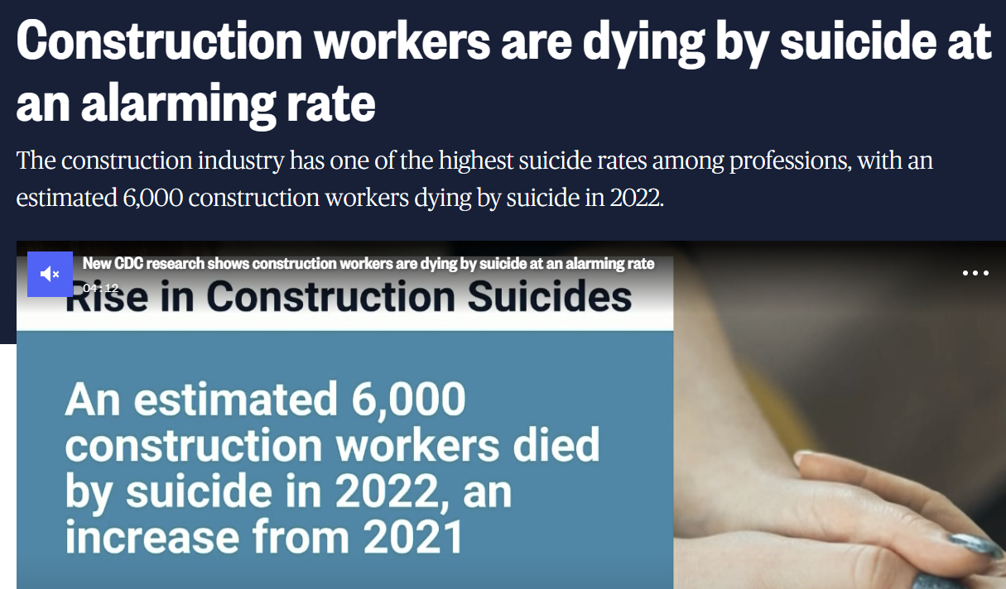
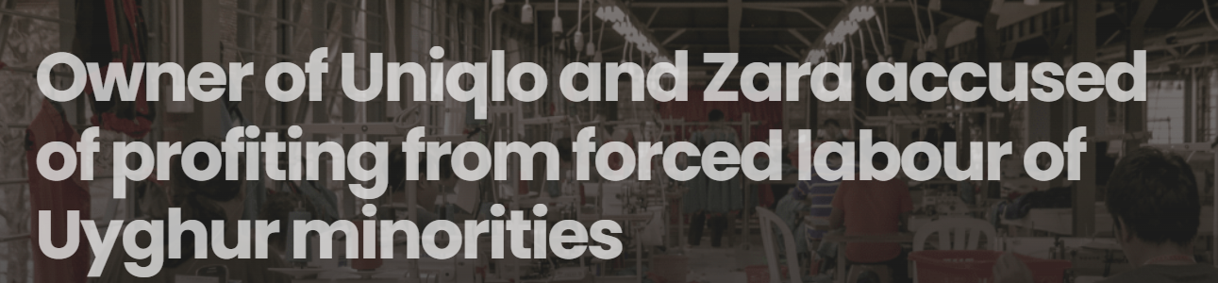
Mental ill health poses a significant human rights risk to companies across industries and geographies

Slide 7
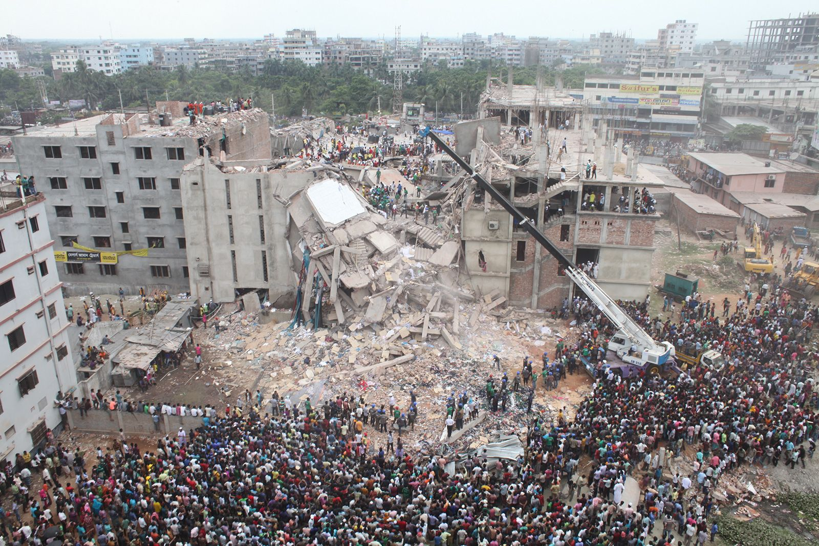
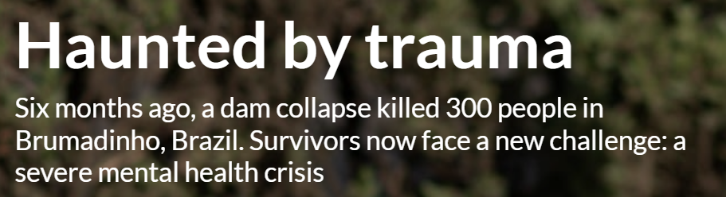
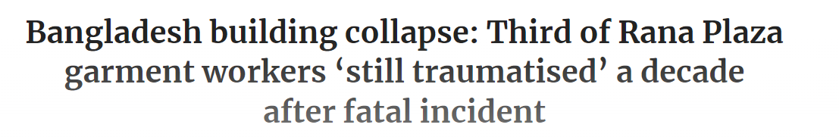



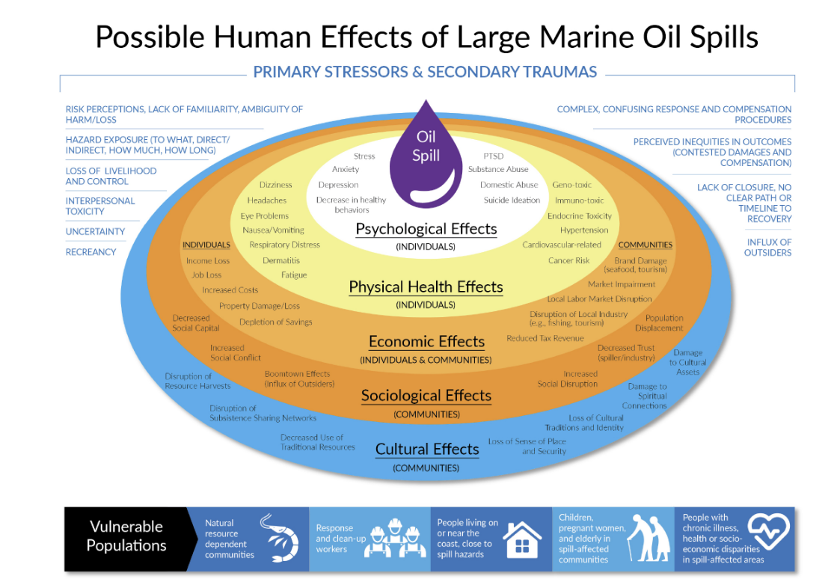
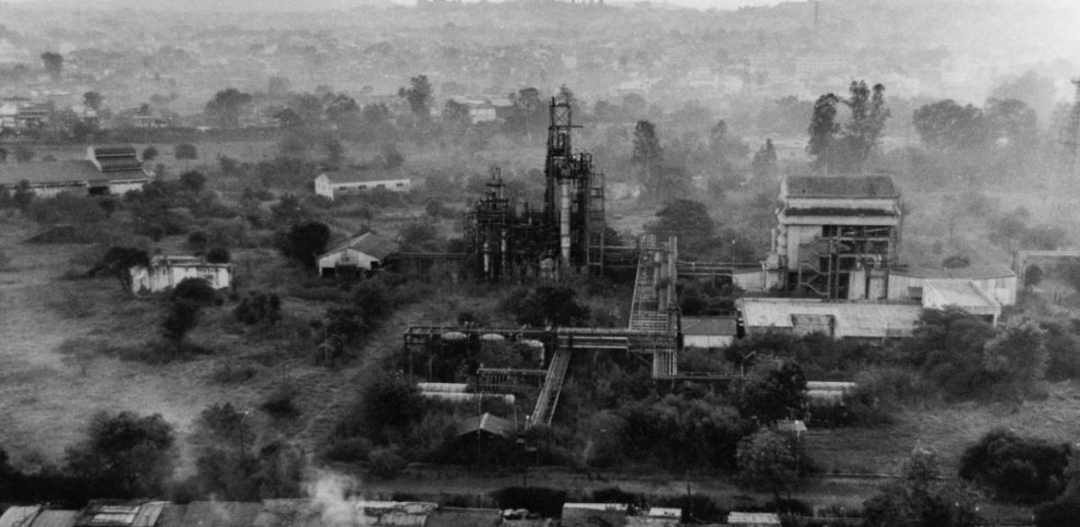


Mental ill health as a result of crisis and critical incidents
Brumadinho
Macondo

Slide 8
Heightened risk contexts: Mental health considerations during crisis and conflict
Companies should be aware that during times of crisis (such as natural disaster) and in conflict and post-conflict contexts, the mental health impacts of their activities, products and services may have a larger adverse impact on an already mentally vulnerable population.
Whilst there can be significant mental resilience shown at such times, companies need to be aware that rightsholders will react and be impacted differently. The fact that some constituents may be more mentally vulnerable during and after these times should be seen as sufficient to warrant additional care by companies to not further exacerbate with additional negative mental or other impacts.

Slide 9
Diving deeper on the nexus between human right and mental health
Now listen to this excerpt from a podcast where the importance of understanding the interconnectedness of human rights and mental health for companies is discussed in greater depth.

Slide 10
Conclusions and key insights
Mental health impacts can be a huge challenge for business, but it's not a challenge that can be ignored.
Because of its cross-cutting nature, adopting a human rights lens to mental health and a mental health lens to human rights, can bring about a real understanding of the impacts and risks as well as a potential wins for the business and for rightsholders, when they get things right.
Knowing there is potential for an impact on psychological health in many areas of business operations, products and services, companies should be placing a much clearer focus on mental health as having the potential to both identify and ameliorate adverse human rights risks and improve effectiveness of remedy for business related human rights harms.

Slide 11
Further resources
Read GBI’s blog to understand more on the linkages between business and human rights and mental health beyond workplace mental health
Listen to the full podcast on the nexus between mental health and business and human rights
Read more about how mental health and remedy are linked in a business context

Slide 12
BUSINESS & HUMAN RIGHTS 101 – LEARNING RESOURCE
CEE&CA Summer Academy on Business and Human Rights 2024
The Global Business Initiative on Human Rights

